Slide 1

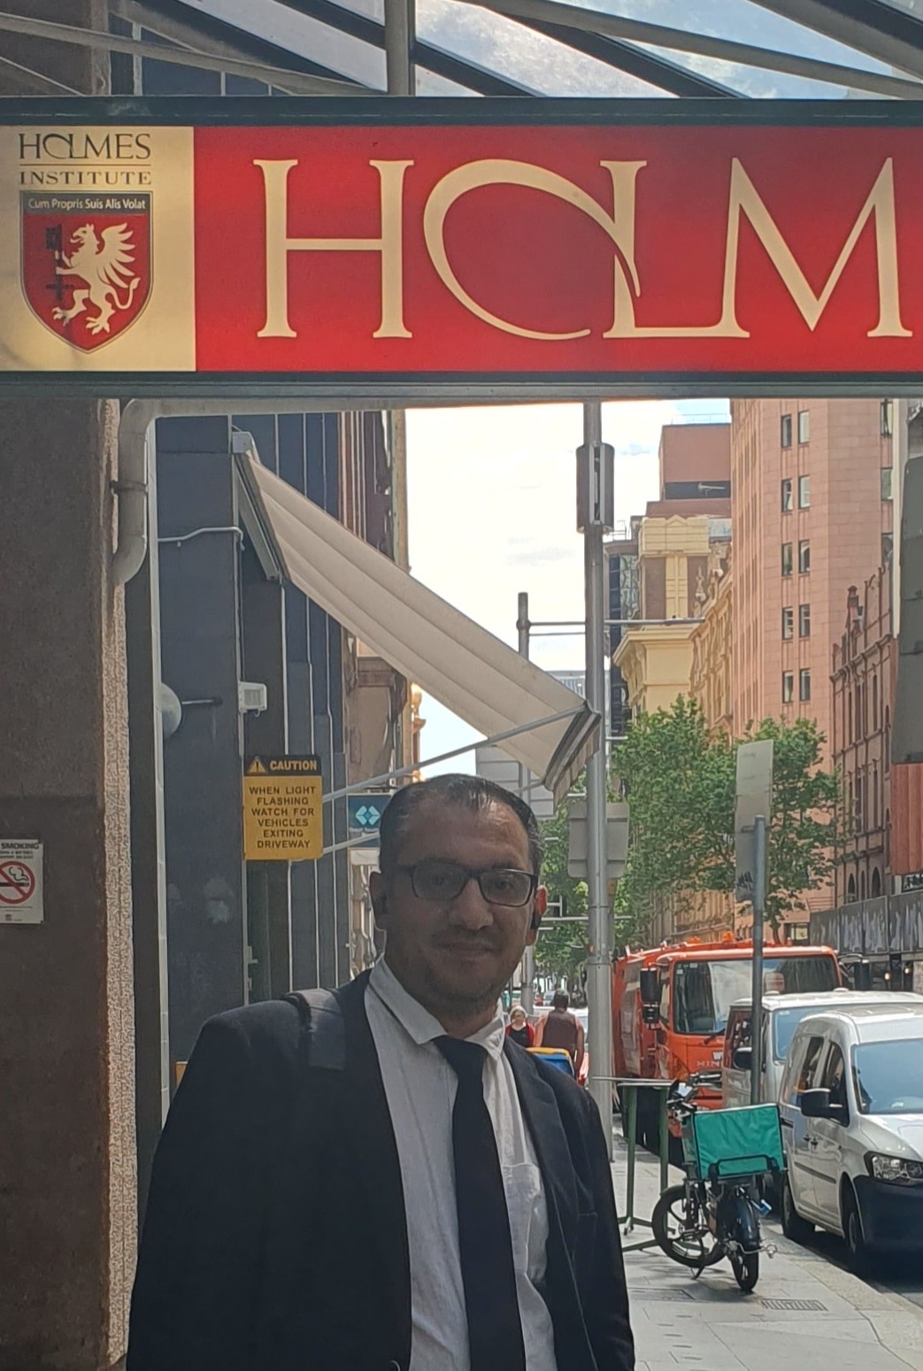
HI6050 – Contemporary Workplace Project
Dr. Farshid Keivanian

Slide 2
Welcome
Welcome to the Contemporary Workplace Project (HI6050)!
In this unit, you'll work in a pre-assigned group on a real-world research topic aligned with your major (Cybersecurity or Data Analytics).
You will collaboratively complete a Research Proposal, submit a Final Report, and participate in bi-weekly in-class meetings (worth 30 marks).
The focus is on:
Research planning & problem-solving
Academic writing and referencing
Professional collaboration and communication

Slide 3
Welcome
Please ensure:
You’ve joined the correct group (same class/campus)
You stay on schedule with weekly deliverables
You attend and document all group meetings
Let’s begin this exciting journey together!

Slide 4
Overview
Unit Description: This capstone unit provides postgraduate students the opportunity to collaboratively apply their knowledge and research skills to solve a real-world workplace problem aligned with their specialisation. Through group-based research or IS project development, students propose, plan, investigate, and present a practical or theoretical solution backed by critical analysis and evidence.

Slide 5
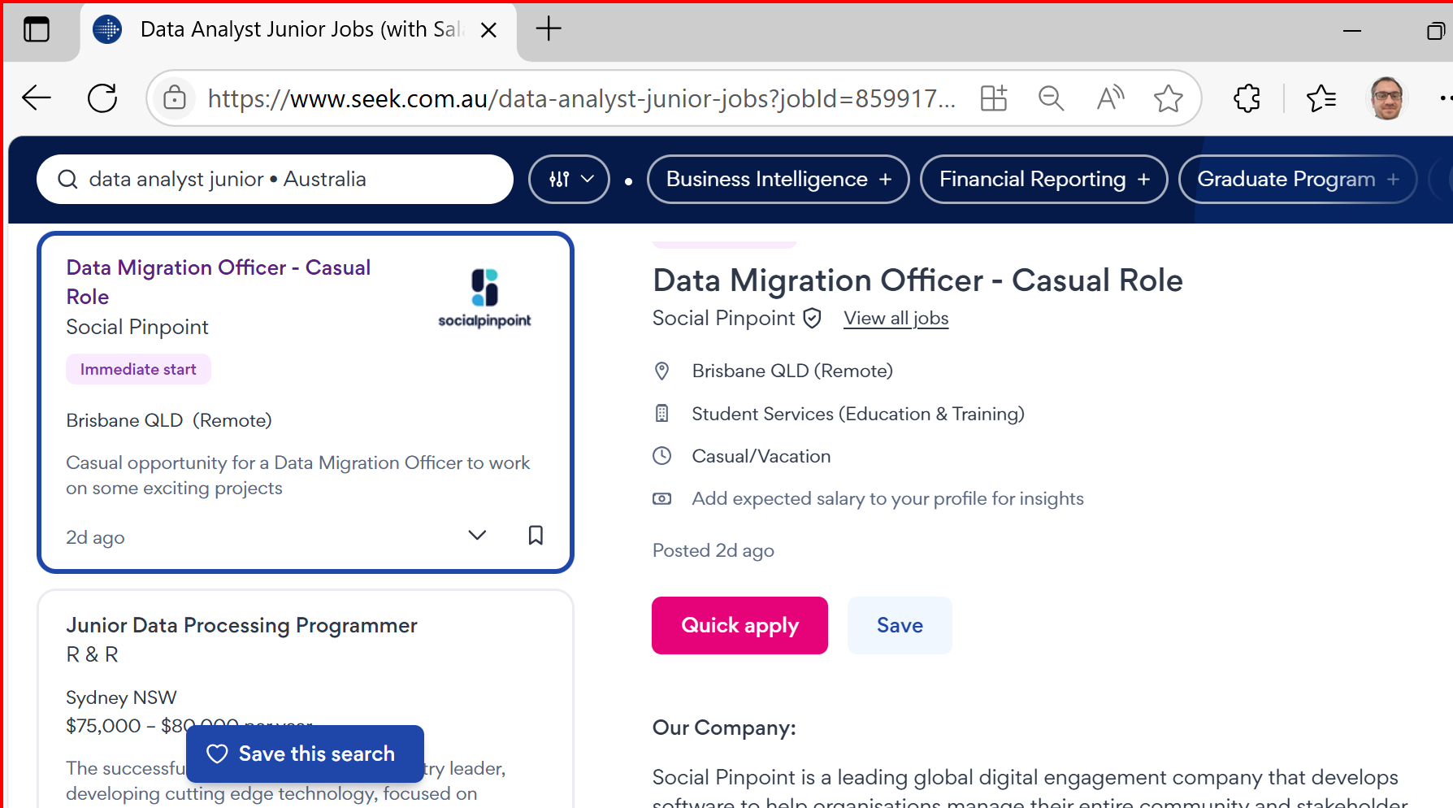
Career Opportunities & Certifications
Job Roles in Australia
Graduates of ICT624 – Advanced Data Analytics are well-positioned for roles such as:
Data Analyst: Interpret complex datasets to inform business decisions.

Slide 6
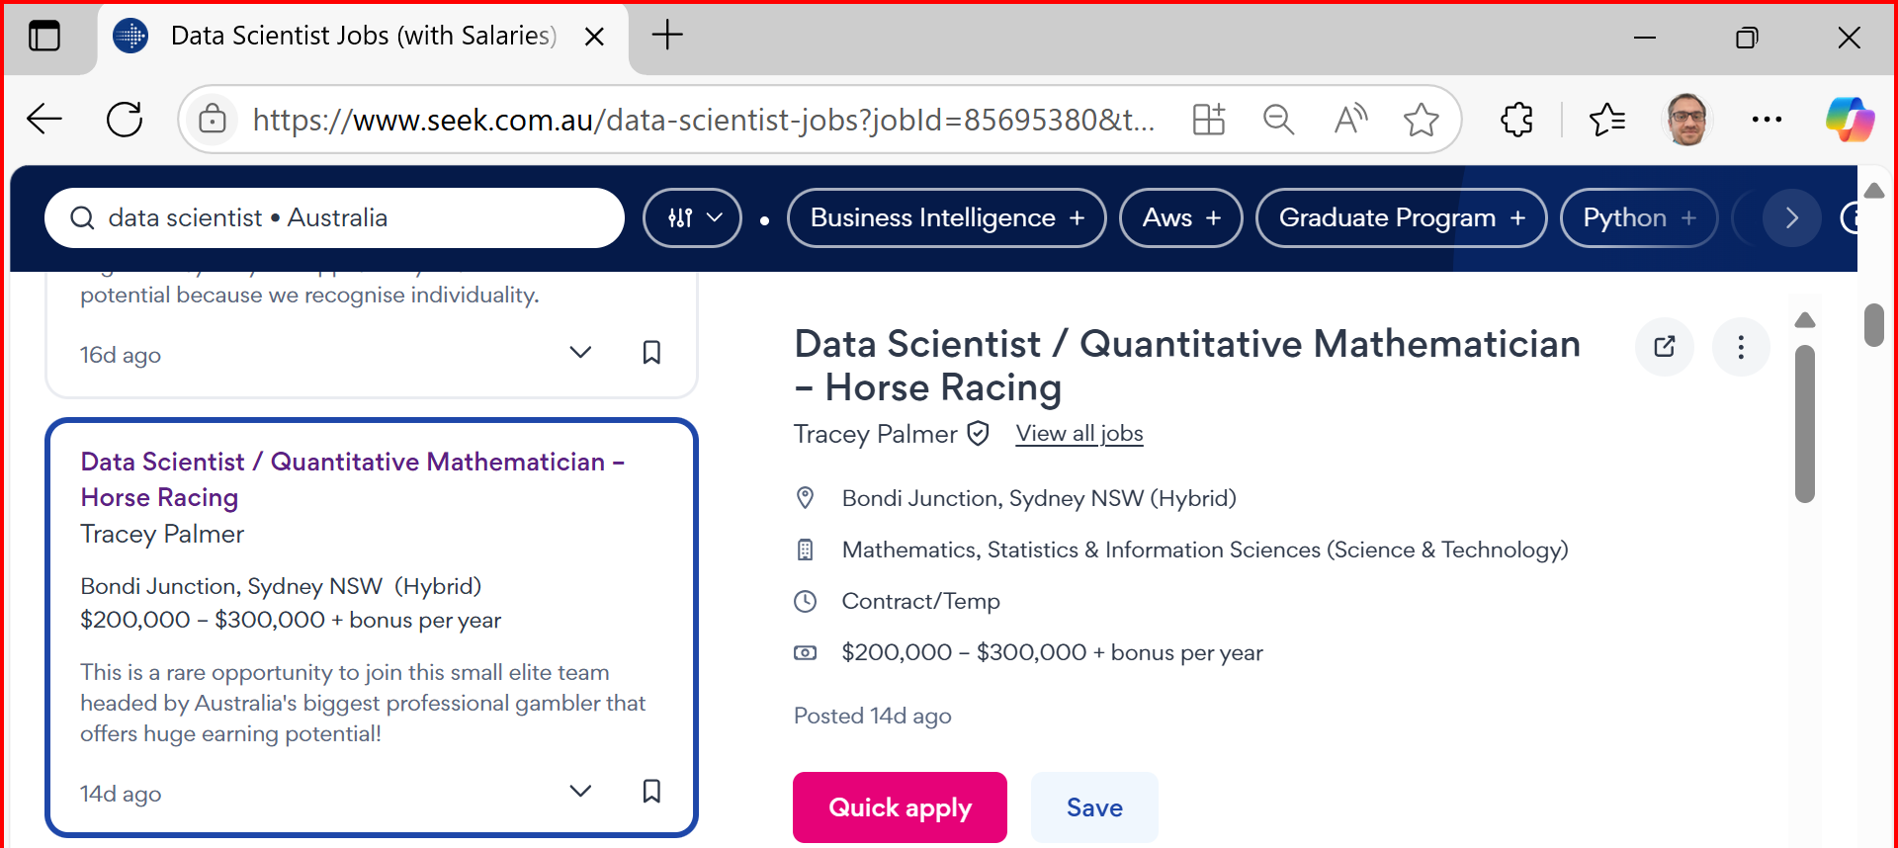
Career Opportunities & Certifications
Data Scientist Develop predictive models and uncover insights using ML & deep learning.

Slide 7
Career Opportunities & Certifications
Business Intelligence Analyst Translate analytics into strategic planning using BI tools.
Machine Learning Engineer Build and deploy scalable ML models in real-time systems.

Slide 8
Career Opportunities & Certifications
AI Solutions Consultant Advise on integrating AI into business operations.
Big Data Analyst Analyse large-scale datasets from cloud or distributed sources.
Advanced Analytics Consultant Design prescriptive models to solve industry-specific problems.

Slide 9
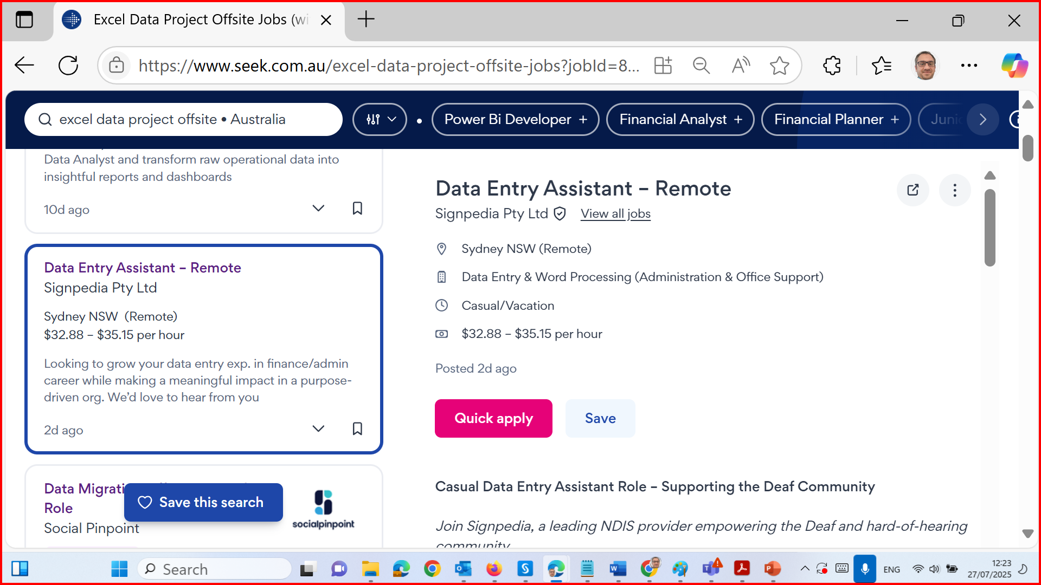
Career Opportunities & Certifications

Slide 10
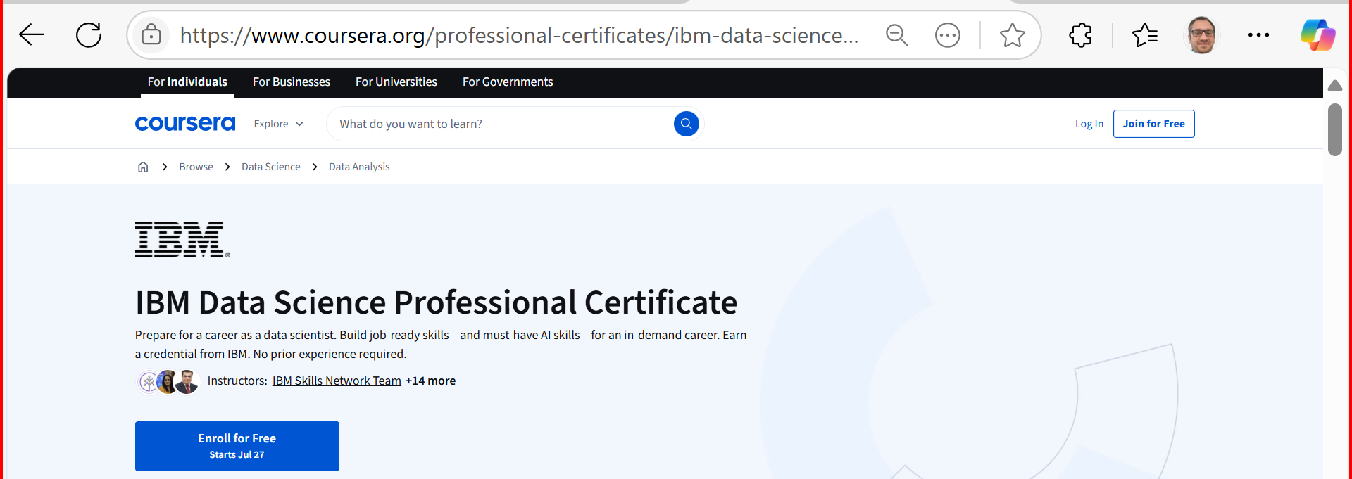
Career Opportunities & Certifications
Relevant Certifications (Optional/Recommended)
Enhance your employability with these recognised certifications:
IBM Data Science Professional Certificate (Coursera)

Slide 11
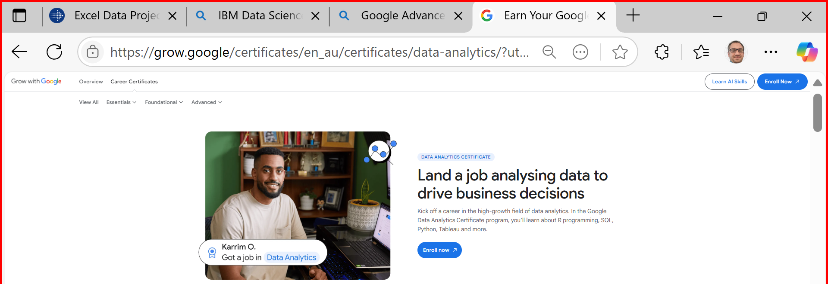
Career Opportunities & Certifications
Google Advanced Data Analytics Certificate

Slide 12
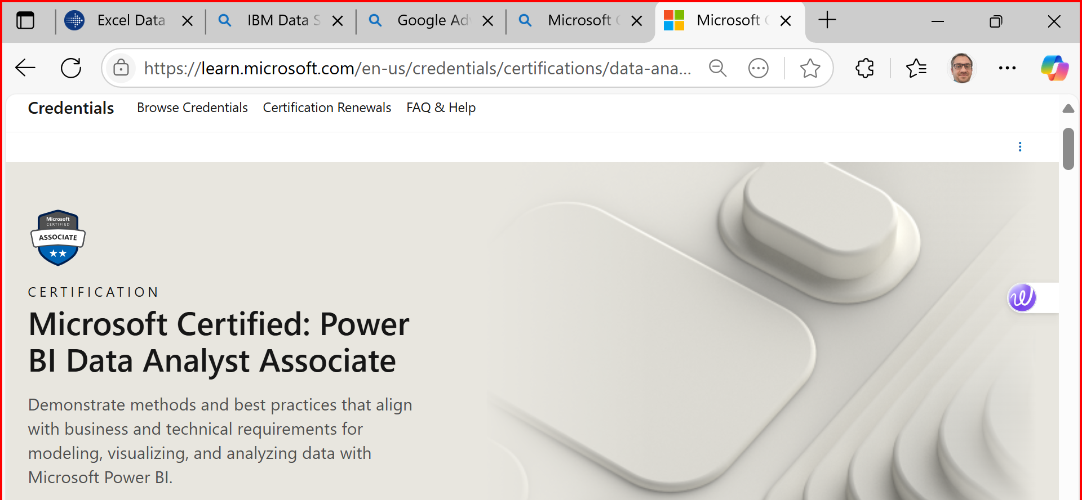
Career Opportunities & Certifications
Microsoft Certified: Data Analyst Associate (Power BI)

Slide 13
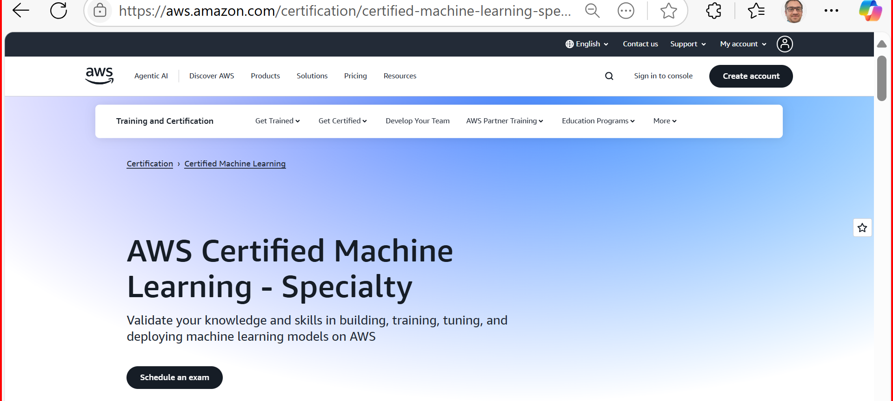
Career Opportunities & Certifications
AWS Certified Machine Learning – Specialty
SAS Certified Advanced Analytics Professional
Databricks Certified Data Engineer Associate

Slide 14
Group Research Proposal – Requirements, Timeline & Expectations
What Is the Group Research Proposal?
The Group Research Proposal is a collaborative project that allows you and your team to explore a real workplace issue related to your major. The final proposal is 1500–2000 words and will form the foundation for your final group presentation and report.
All parts of the proposal are built gradually across Weeks 3 to 6, so it is essential to attend tutorials and work closely with your group each week.

Slide 15
Assessment Dates and Structure
 | T1, 2025 (Old) | T2, 2025 (New)
Group Research Proposal | Due 2 May 2025 | Now due 29 August 2025
Group Report | Due 6 June 2025 | Now due 3 October 2025
Presentation | Due 10 June 2025 | Removed / replaced with Group Meetings
Progress Reports | Not listed | Now included: 4 bi-weekly reports (Week 5–12), 30 marks total

Slide 16
Assessment Overview, T2, 2025:
Component | Due Date | Weight | Details
Group Research Proposal | Week 7 (29 Aug 2025) | 30% | 1500–2000 words + meeting minutes + references
Group Final Report | Week 11 (3 Oct 2025) | 40% | Full research paper + appendix
Group Meetings (x4) | Weeks 5–12 (class time) | 30% | In-class, bi-weekly, documented in template

Slide 17
Group Meeting Requirements – New Addition
New in Trimester 2: 4 bi-weekly in-class group meetings
Groups meet odd/even weeks based on group number
Minutes must be included in the final submission
Roles assigned during meetings: Chairperson, Minute-taker, (optional) Timekeeper
Week 2 Action:
Explain that students must attend all 4 meetings to receive marks
Review the Group Meeting Guide (professionalism, agenda, roles, minutes)
Add a reminder to include the meeting minutes in the final report appendix

Slide 18
Pre-Assigned Topics – Fixed Group Allocation
 | Old | New
Students could choose from a topic list (Cyber/Data) | Students are automatically assigned topics based on their Group Number
Broad list of ~50 topics | Now only 20 fixed topics (Cybersecurity)
Titles had example RQs | Now each topic includes Background + Research Question

Slide 19
Pre-Assigned Topics – Fixed Group Allocation
Week 2 Action:
Clarify: “You must work on your pre-assigned topic” (can’t swap)
Mention that the new format gives structured guidance with background context
Use this to help students brainstorm their Research Title and Abstract (Week 3 deliverables)

Slide 20
Proposal Content & Structure – Mostly Unchanged
The step-by-step weekly breakdown of Research Proposal remains largely the same (Week 3–6)
Still includes: Title, Abstract, Intro, Problem Statement, Question/Objectives, Scope, Methods, Plan, Timeline, Conclusion
Week 2 Action:
Encourage students to start working on:
Research Title (concise and meaningful)
Initial Abstract draft
Review and understand the background of their assigned topic

Slide 21
Class Participation Expectations (Reinforced)
Stronger emphasis on:
Joining correct group (must be from same campus/class)
Attendance & engagement in classes
Use of Drop-in Sessions, Discussion Boards, and in-class supervision
Week 2 Action:
Encourage early engagement and proactive team communication
Reinforce that performance in group meetings impacts individual marks

Slide 22
What's New in Trimester 2, 2025 – HI6050
Group Progress Meetings are now compulsory – 30 marks (Week 5–12)
Topics are assigned automatically – no swaps allowed
New due dates: Proposal – Week 7, Final Report – Week 11
Meeting Minutes required for final report – use the provided template!
Stay active: Attend classes, communicate often, and work collaboratively!

Slide 23
Group Research Proposal – Requirements, Timeline & Expectations
What You Must Do (Step-by-Step):
Week | Deliverable | Description
Week 3 | Research Background | Draft a clear Research Title, write the Abstract, and develop your Introduction, Problem Background, and Problem Statement
Week 4 | Research Questions & Methods | Define your Research Objectives, Research Question, Project Scope, and explain your Research Methods (must be a literature review – qualitative approach)

Slide 24
Group Research Proposal – Requirements, Timeline & Expectations
What You Must Do (Step-by-Step):
Week | Deliverable | Description
Week 5 | Research Plan | Add any Preliminary Results, draw a Project Timeline (e.g., Gantt chart), and write a short Conclusion. Begin compiling your References
Week 7 | Full Proposal Submission | Submit the final, polished document with ALL SECTIONS from Weeks 3–5 + References using Holmes Adapted Harvard Style Final proposal due Week 7 – submit via Blackboard by 29 August 2025, 11:59 PM (AEST).

Slide 25
Group Research Proposal – Requirements, Timeline & Expectations
What to Avoid:
X Joining more than one group (you will be removed from all if found in multiple)
X Forming groups across different classes (e.g., M1 students must form groups with M1 only)
X Waiting until the last week – this is a staged submission and must be developed progressively
X Submitting solo (unless assigned by deadline – 20% penalty applies to all assessments)

Slide 26
Group Research Proposal – Requirements, Timeline & Expectations
What to Submit (Week 7):
Final Group Research Proposal (1500–2000 words) in Word or PDF format
References List using Holmes Adaptive Harvard Style
Cover Page with all Group Member Names and Student IDs clearly stated
Appendix: Group Meeting Minutes (from 4 in-class meetings, signed & structured)

Slide 27
Group Research Proposal – Requirements, Timeline & Expectations
What to Do in Each Tutorial:
Week | In-Class Focus
Week 3 | Form group (if not already), brainstorm research topics, assign sections to members, begin drafting Title, Abstract, Intro, Problem
Week 4 | Finalise Research Question, confirm Objectives and Scope, decide on Methods, write rationale
Week 5 | Share preliminary literature review findings, build Timeline (e.g. Gantt Chart), draft Conclusion and References
Week 6 | Final review of full proposal, proofreading, referencing check, prepare for Week 7 submission (29 August 2025)

Slide 28
Group Research Proposal – Requirements, Timeline & Expectations
Final Tips:
Meet regularly outside class to stay on track
Use Blackboard Discussion Board or Drop-in Sessions for support
Ask your tutor for feedback on each section before the Week 7 submission
Double-check inclusion of Group Meeting Minutes in the final document
We’re here to support you every step of the way. Good luck with your research journey! Dr. Farshid Keivanian

